Slide 1
Internship Project Title
Presented By:
Uday Ishvarbhai Panchal
(210303124119)
Department mentor:
Pragya Devi
Designation
AI & AIDS Department
PIET, Parul University
Industry mentor:
Bhanu Pratap Singh
Manager
End Semester Internship Examination, March/April 2025

Slide 2
Index
CHAPTER 1: Introduction to VAPT
CHAPTER 2: Tools Used in VAPT
CHAPTER 3: Web Structure
CHAPTER 4: Exploring Dark Web
CHAPTER 5: Introduction to Web Scraping

Slide 3
Introduction to VAPT
What is VAPT?
VAPT stands for Vulnerability Assessment and Penetration Testing.
A security testing process used to identify and fix vulnerabilities.
Key Components:
  Vulnerability Assessment: Identifies security flaws.
  Penetration Testing: Actively exploits weaknesses to evaluate risks.

Slide 4
Introduction to VAPT
Who Needs VAPT
  Industries requires VAPT (IT companies , Banks , Government Agencies , etc.)
Why is VAPT Important ?
  Prevents Data Breaches and Cyber Attacks .
  Helps Companies with Security Standards (ISO 27001 , PCI DSS , GDPR)

Slide 5
Introduction to VAPT
How is VAPT Performed?
Information Gathering (Reconnaissance).
Scanning & Enumeration.
Exploitation & Attack Simulation.
Reporting & Remediation.

Slide 6
Information Gathering (Reconnaissance)
Definition : The Process of collecting information about a target before launching an attack .
Types :
Active Reconnaissance : Direct intersection with the target
Passive Reconnaissance: Collecting Information without direct interaction .

Slide 7
Tool | Purpose | Command Example
Google Dorking | Find sensitive information using Google search queries. | site:target.com filetype:pdf confidential
WHOIS Lookup | Find Domain owner Details | Whois example.com
Nslookup/Dig | Get DNS records of a Target | Nslookup example.com
theHarvester | Collect emails , Subdomains .etc | theHarverster –d example.com –l 500 –b google
Shodan | Search for internet exposed device | Shodan search “port:22 country:IN”
Maltego | OSINT tool for Mapping relationships | GUI-Based tool
Recon-ng | Framework for automated reconnaissance | Recond.ng -> modules add domain-hosts

Slide 8
Scanning & Enumeration
Definition : Identifying live systems , open ports, services , and vulnerabilities in a network
Tool | Purpose | Command
Nmap | Scan networks for open ports and services | nmap –A (IP)
Masscan | Faster alternative to nmap for port scan | Masscan –p- (IP) –rate=1000
Netcat(nc) | Check if a port is open | Nc –zv target.com 80
Nikto | Web server vulnerability scanners | Nikto –h (ip)
Dirbuster | Brute-force Directories , files . | Dirb (ip)
Wpscan | Wordpress vulnerability scanner | Wpscan –url (url) –enumerate

Slide 9
Exploitation & Gaining Access
Definition: The phase where vulnerabilities are exploited to gain unauthorized access to a system.
Types:
  Remote Exploitation – Exploiting a system over a network.
  Local Exploitation – Exploiting a system after gaining local access.
  Privilege Escalation – Elevating user permissions

Slide 10
Tool | Purpose | Command
Metasploit | Exploit and gain access . | Msfconsole -> use exploit/multi/handler
Searchsploit | Find public exploits | Searchsploit apache 2.4.49
ExploitDB | Online database of exploits | https://www.exploit-db.com
SQLMap | Exploit SQL injection vulnerability | Sqlmap –u “websiteurl” –dbs
Hydra | Brute-force login credentials . | Hydra –l admin –P rockyou.txt ssh://IP
Jhon the Ripper | Password Cracking tool | Jhon hash.txt –wordlist=rockyou.txt
Project Presentation 2023

Slide 11
Attack Simulations (Post-Exploitation & Pivoting)
Definition: Simulating real-world cyberattacks to test security defenses.
Steps:
  Persistence – Maintaining access to the system.
  Privilege Escalation – Gaining higher-level access.
  Lateral Movement – Expanding access to other systems.
  Data Exfiltration – Stealing sensitive information.
Project Presentation 2023

Slide 12
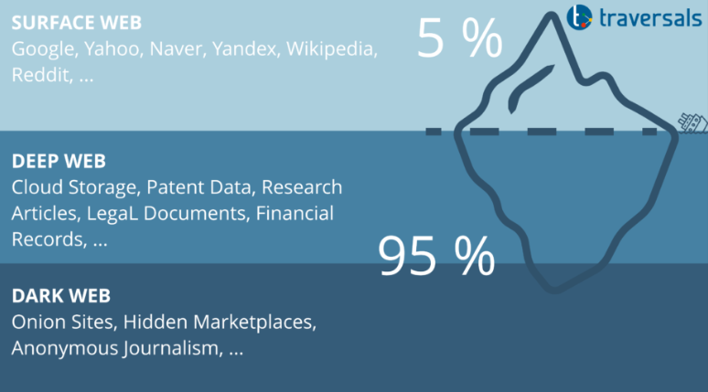
Web Structure.
Surface Web (Clearnet)
  Definition : The publicly accessible part of the internet that search engines like google , Bing can index
  Size : 5-10% of the entire internet .
  Example :
    Google , Wikipedia , YouTube
    News Website, E-commerce
    Government Portals
Project Presentation 2023

Slide 13
  What Information:
    General knowledge
    Public social media profiles
    Education and research materials
Deep Web (Invisible Web)
  Definition: The Part of internet not indexed by search engines but still legal and accessible with login credentials
  Size : 90-95% of the entire internet .
Project Presentation 2023

Slide 14
  Examples :
    Private emails , medical records , financial data
    Corporate database , academic journals
    Online banking portals , private cloud storage
  What we get ?
    Academic research papers
    Confidential company data
    Medical records
    Government Database
Project Presentation 2023

Slide 15
Dark Web (Hidden Web)
  Definition: A small part of Deep web that requires special software to access . It is often associated with privacy , anonymity and illegal activities .
  Size : less than 0.1% of the deep web .
  Examples :
    Darknet Markets
    Fourms for privacy activists , journalists ., and hackers
    Onion websites
Project Presentation 2023

Slide 16
  What we get ?
    Privacy-focused fourms .
    Cybersecurity resources and leaked databases.
    Cryptocurrency exchanges
    Black markets
    Hacking Fourms and cybercrime network.
Project Presentation 2023

Slide 17
How to Use The Dark Web
To use the DARK WEB there is a different browser for its “TOR” browser .
  The onion router (TOR) is privacy-focused network that enables anonymous browsing by encrypting and routing internet traffic through multiple volunteer-operated servers .
  It also have TOR Network that work different way to provide anonymity.
Project Presentation 2023

Slide 18
How tor works
  Entry Node : Your data is encrypted and enters the TOR network through a random server .
  Middle Nodes : Traffic is routed through multiple relays , hiding the origin and destination .
  Exit Node : The final relay decrypts the last layer and forwards the request to the target website
  Each relay knows only its previous and next hop , ensuring anonymity .
Project Presentation 2023

Slide 19
Dark Web Search Engines
  In dark web you can not access any normal websites
  Each websites require .onion to run .
  For that there is certain search engines in dark web :
    DuckDuckGo
    Ahmia
    OnionLand etc.
Project Presentation 2023

Slide 20
Web Scraping
What is Web Scraping ?
  Extracting data from websites using scripts .It is widely used for data analysis , research , market , intelligence and automation
  Type of Scraping
    Static Scraping : Extracting data from static webpages .
    Dynamic Scraping : Handling JavaScript –using selenium ,etc.
    API scraping : Accessing structured data through RESTful APIs.
    Headless Scraping : Running a browser without a UI .
Project Presentation 2023

Slide 21
Tools Used For Web Scraping
  BeautifulSoup : Parses HTML and XML to extract data .
  Scrapy : A powerful Python Framework for large-scale scraping.
  Selenium : Automates browser actions (used for dynamic websites)
  Puppeteer : A Node.js library for headless chrome browser control.
Project Presentation 2023

Slide 22
Setps in Web Scraping
  Inspect the website Structure .
  Identify Unique IDs , Classes or Xpaths
  Choose Scraping method
  Write the scraping Script
  Store data
Project Presentation 2023

Slide 23
from selenium import webdriver
from selenium.webdriver.common.by import By
import time
# Set up the WebDriver
driver = webdriver.Chrome() # Ensure chromedriver is installed and in PATH
# Open the website
url = "https://quotes.toscrape.com/"
driver.get(url)
# Wait for page to load
time.sleep(2)
# Extract all quotes using XPath
quotes = driver.find_elements(By.XPATH, '//span[@class="text"]')
authors = driver.find_elements(By.XPATH, '//small[@class="author"]’)
# Print the extracted quotes and authors
for quote, author in zip(quotes, authors):
print(f'"{quote.text}" - {author.text}')
# Close the browser
driver.quit()
Example of Web Scrapping with selenium and Xpath .
Project Presentation 2023

Slide 24
Thank you

